Slide 1


UNIVERSUM
Introduction to
Level Design & Game Asset Creation
Carl Good (st20229259)
CIS5014_T1_PORT1

Slide 2
Populous II – Remade for the Future!
Taking inspiration from Populous II, my 3D Models and designed levels will introduce its own twist to the classic simulation-strategy game.
And to do so, I have opted for a more futuristic turn to PII; each character, environmental entity and structure will look as if it had come from space.
The idea of this game is to migrate onto a new planet and create neverbeforeseen structures and landscapes.

Slide 3


3D Modelling –Blender v. 3DsMax
As the industry standard, 3DsMax is the popular choice when modelling for this assignment. However, it is software that I am briefly unfamiliar with. Luckily, I have experience using Blender – an alternative 3D modelling and utility software.

Slide 4
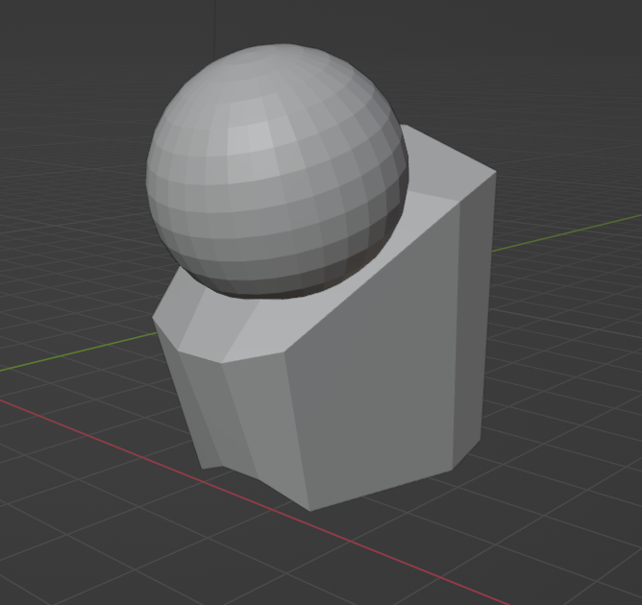
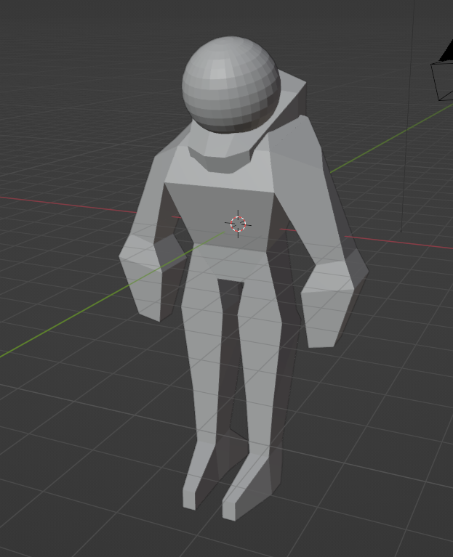
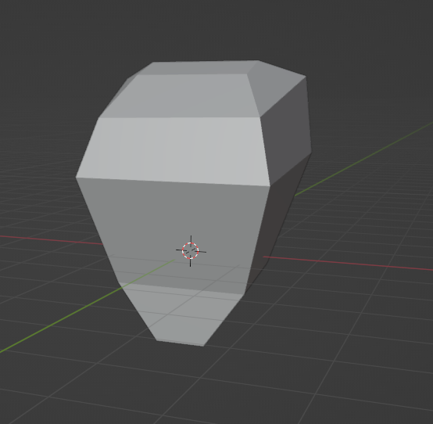
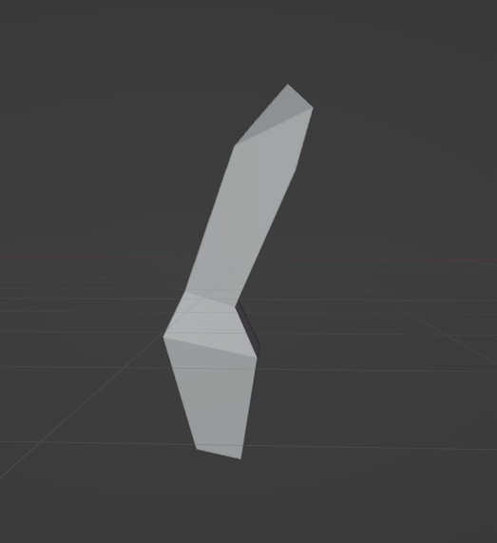
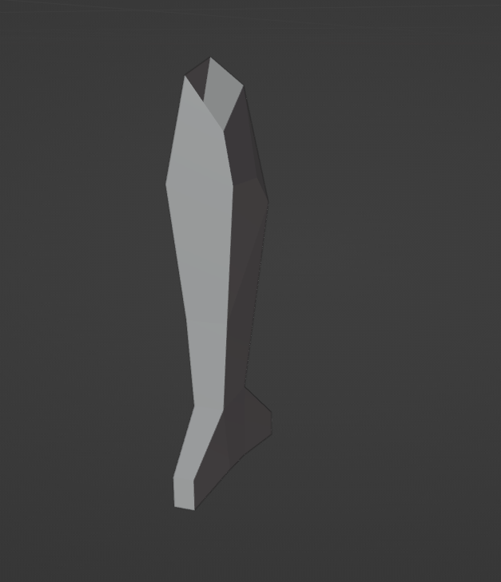



3D Modelling – Male Character
I decided to create a space-man as I believed it would be a crucial character for my game. Who else to explore the cosmos than them?
I was inspired by Commando from the Risk of Rain franchise and have always enjoyed low-poly models of characters.
Duplicate limbs (arms & legs) were made then pasted + mirrored + connected to torso

Slide 5
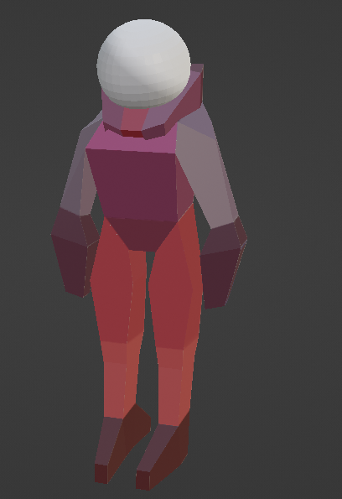

3D Modelling – Female Character
Saved time to use the same assets for both.
For a game like P2, character model details do not matter as much especially with an isometric view.

Slide 6
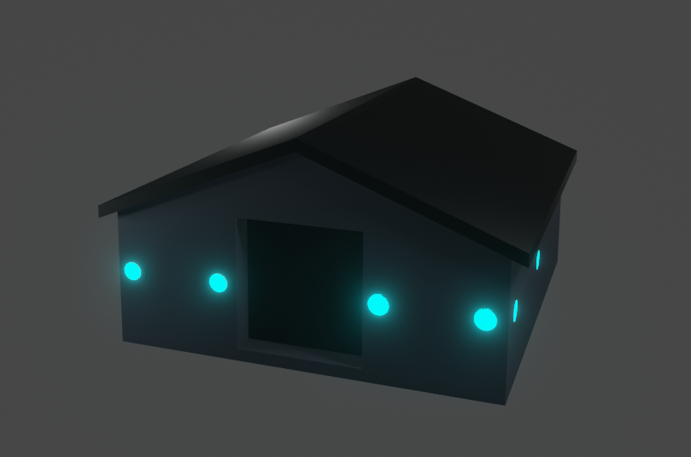
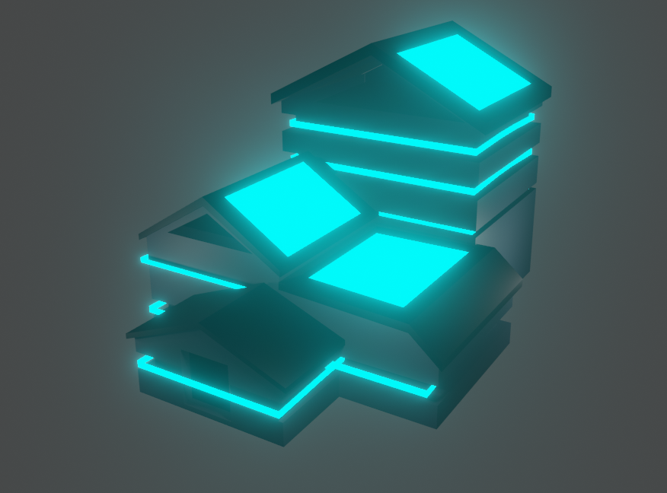
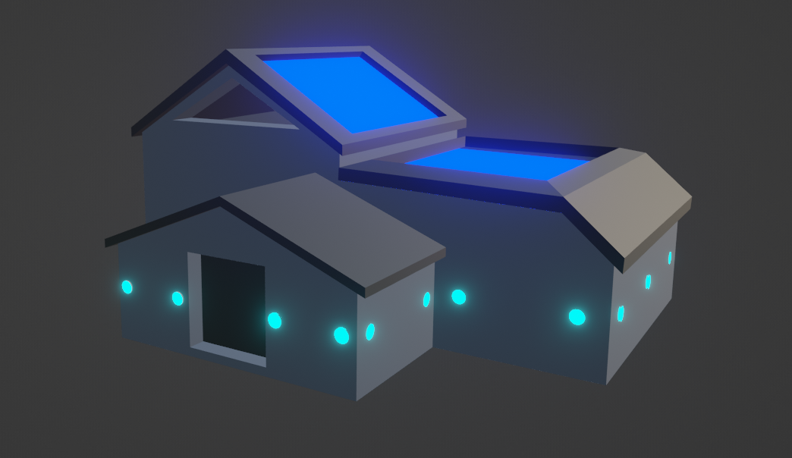

3D Modelling – Structures
Notes:
The base model I decided to create was a small house. To make it suit the aesthetic, I gave it neon lights.
The second iteration of this model was to add a garage and other rooms to it. I also decided to add solar panel-like plains on the roofs and also gave them a luminescent material.
The final stage of this model I thought to add a filler at the back of the house. Can be used as a storage facility or extra housing. It then seemed a bit too dark, so I added some neon beams around each of the parts of the house and also gave it a lit-up roof. Replacing the neon lights with the beams makes it look neater.

Slide 7
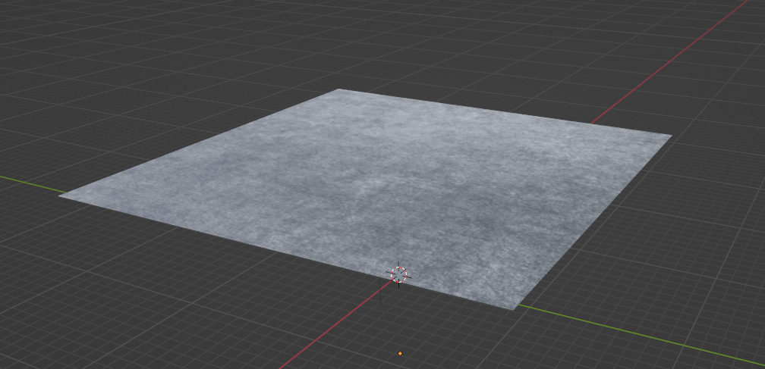
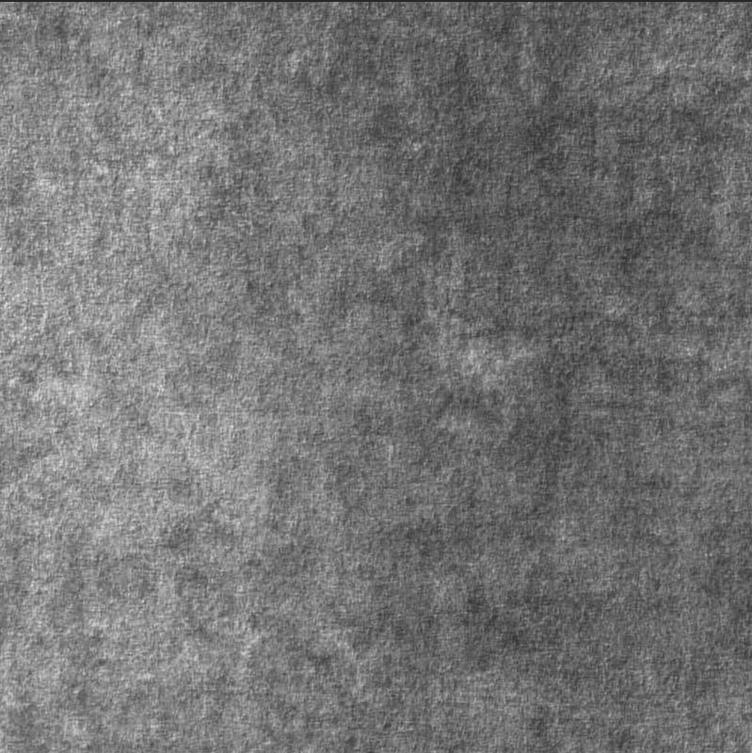
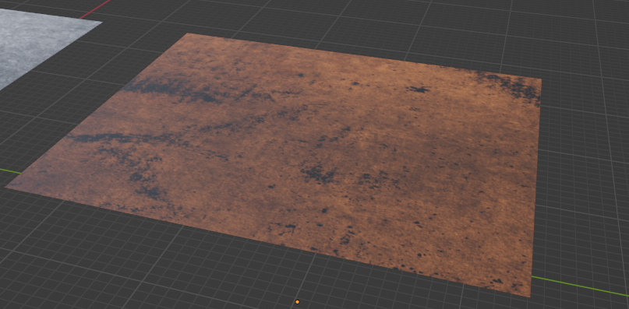
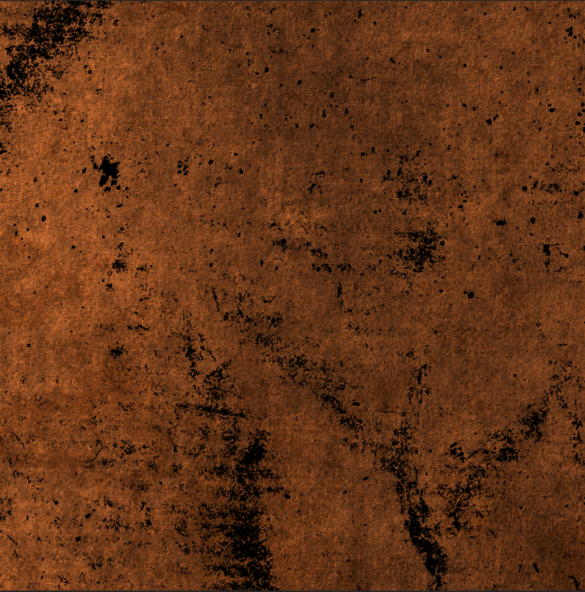
3D Modelling – Environment

Slide 8
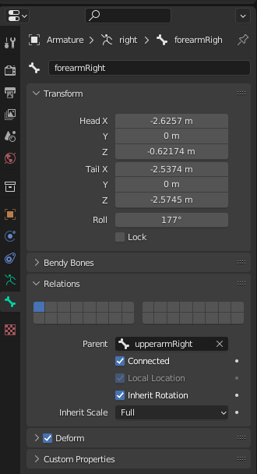
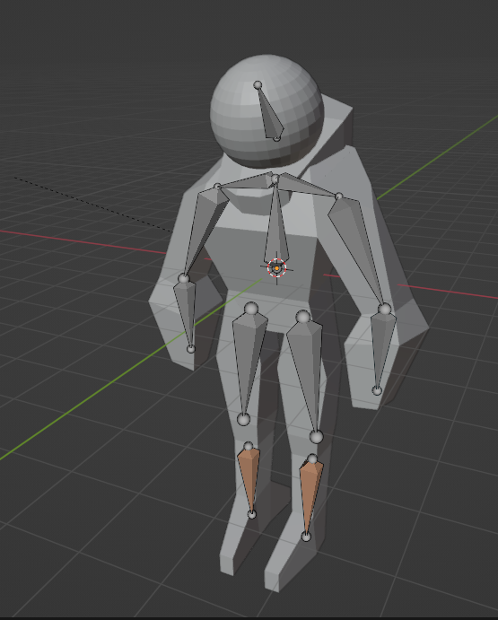
Animation – Character Rigging
Connected a series of bones on one side, then symmetrised onto the other. Works best when initial set of bones have correct names (upperarmRight, forearmRight).
Removed unused or unneeded bones to make the rig simpler.

Slide 9
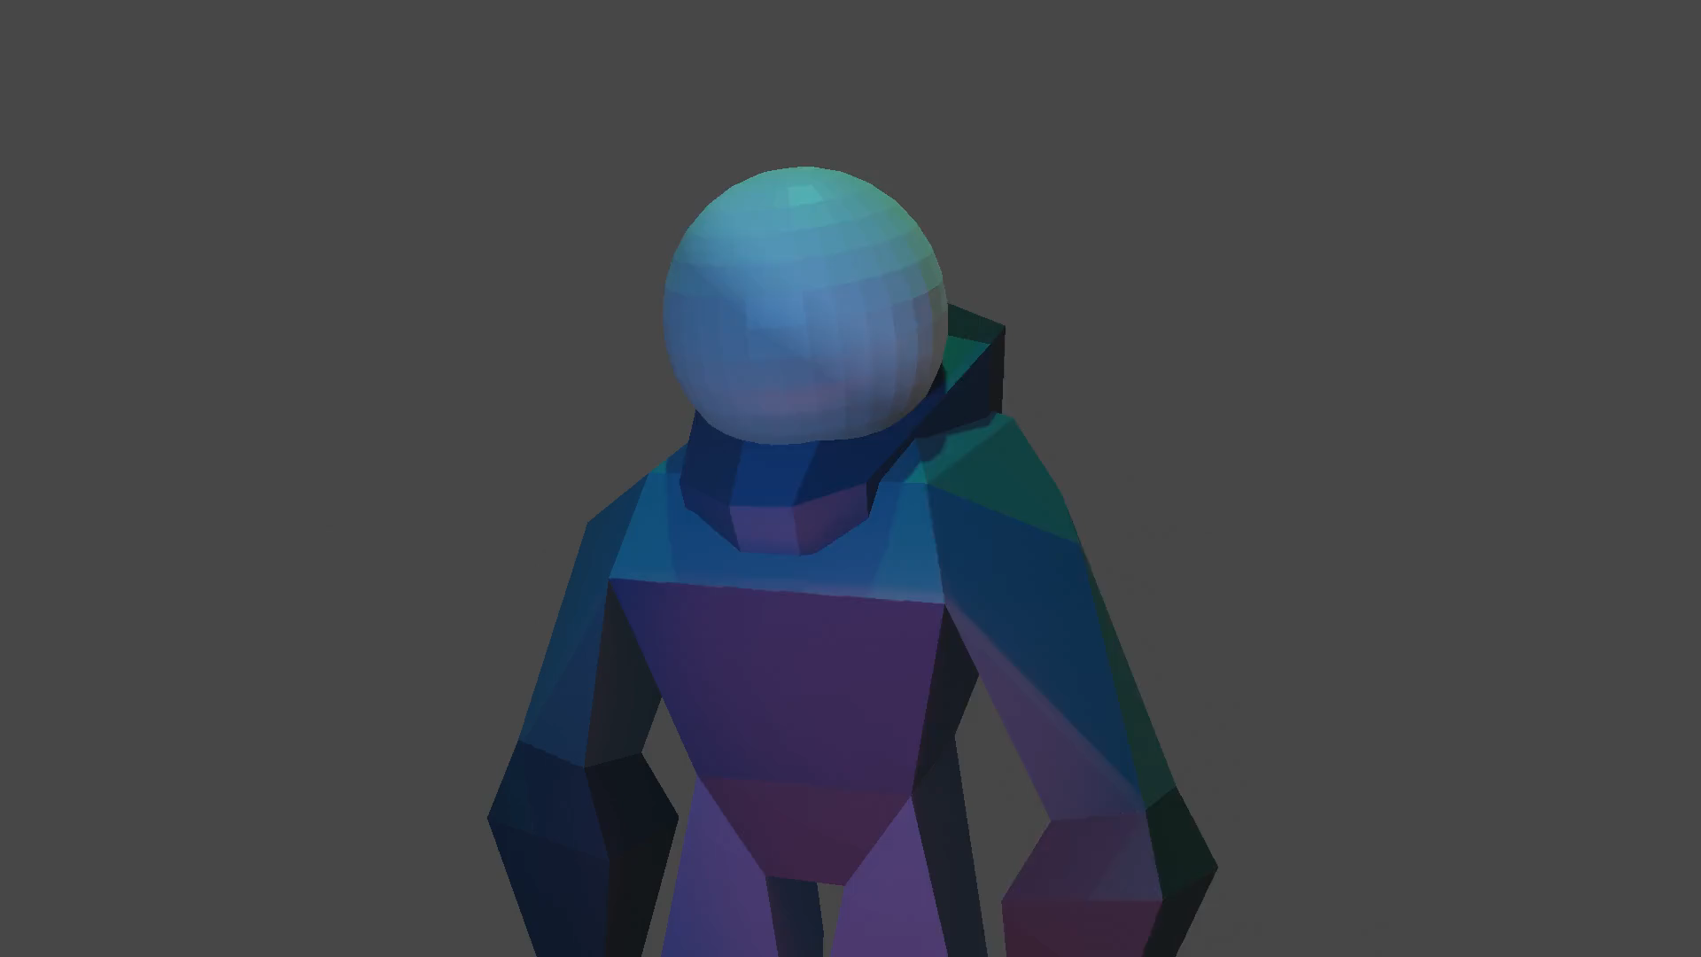
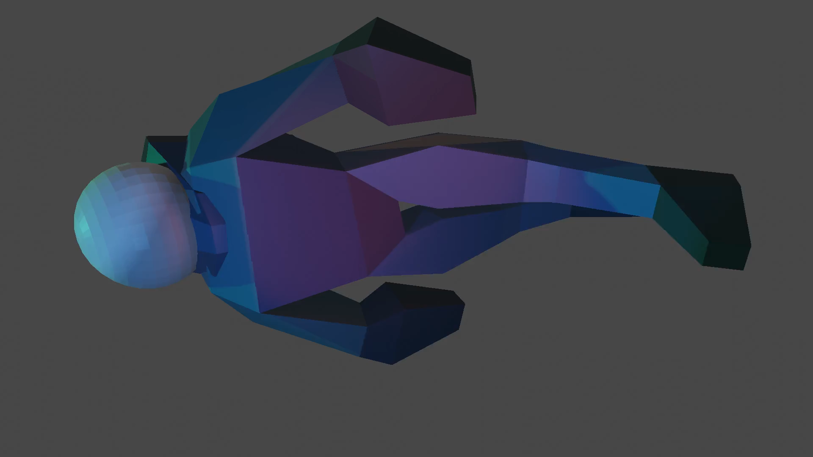
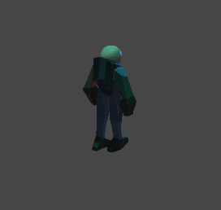
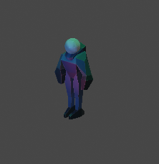
Animation – Sequence
(CLICK TO PLAY)

Slide 10
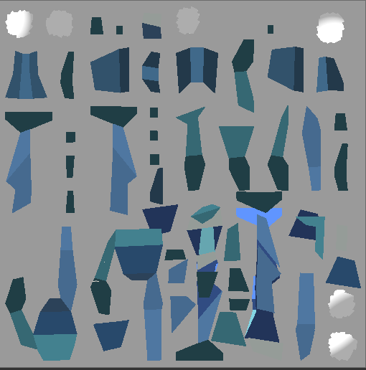
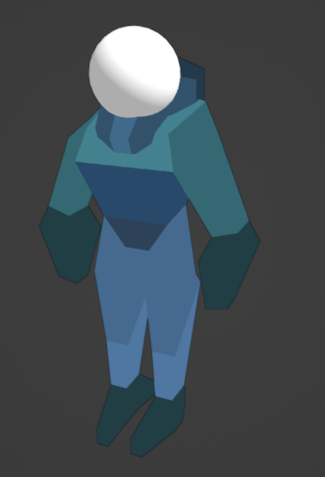
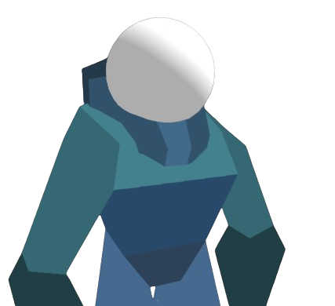
Textures – Male Character
wow.

Slide 11
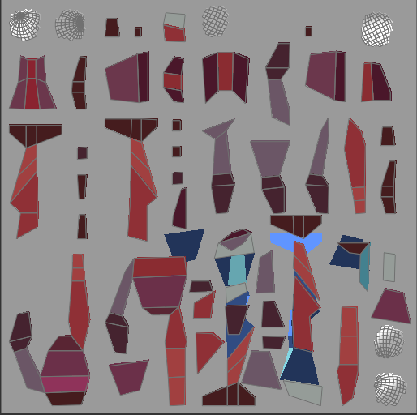
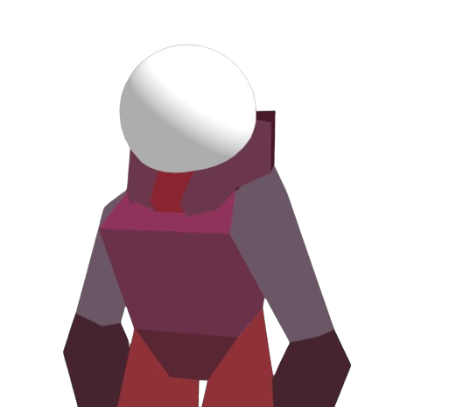
Textures – Female Character
this looks familiar.

Slide 12
Poly Count Total
Model | Poly Count
Male Character | 629
Female Character | 629
Small House | 78
Medium House | 151
Big House | 399
Moon Platform | 481
Mars Platform | 481
Total | 2,848

Slide 13
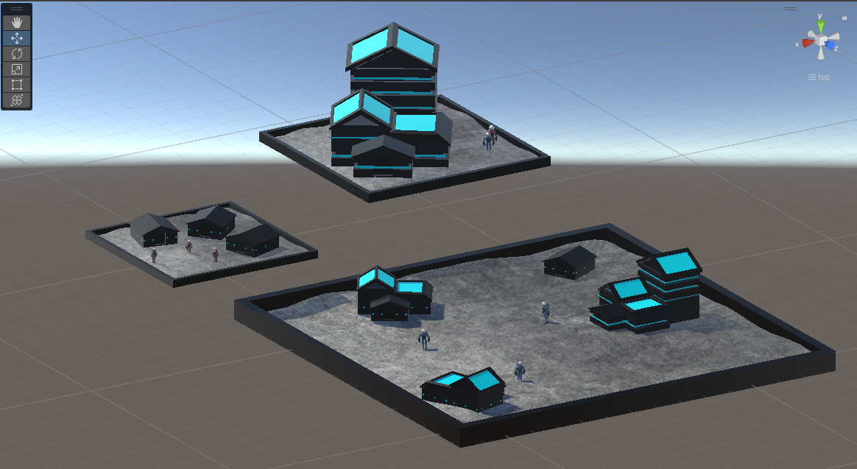
Level Design – #1 Moon
The first level will be based on the Moon and offer three platforms that the player must terraform and build structures on for his civilisation.
The astronauts can jump from platform to platform by utilising their jet boosters on their backs. The higher floors are only available once a lower one has been successfully terraformed

Slide 14
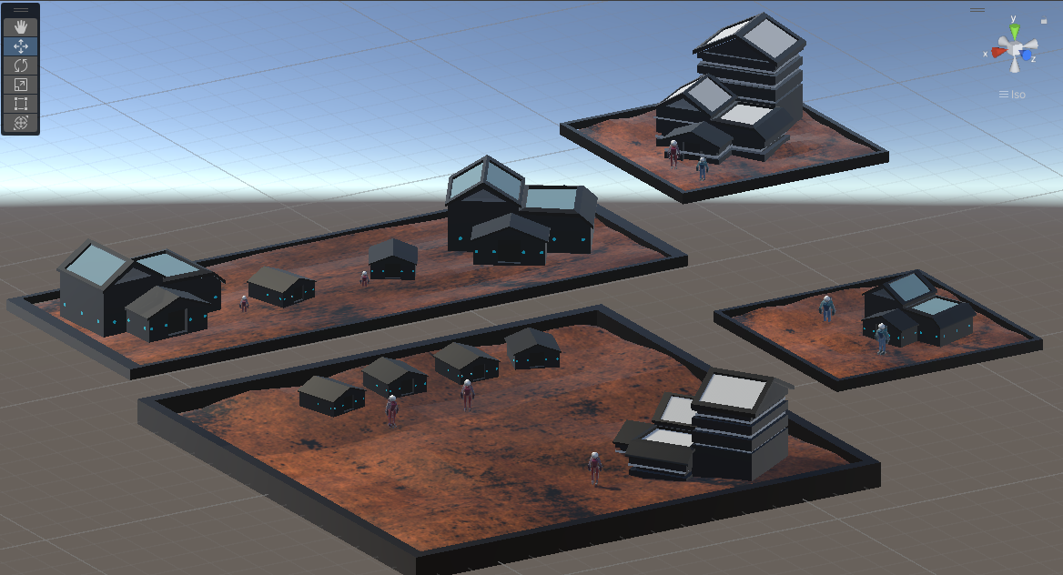
Level Design – #2 Mars
This second level was based on Mars and offers four platforms to terraform. This design is slightly more complex to complete as it offers an extra floor.
It also offers more space, meaning the player will have to expend more resources and take more time to complete it.

Slide 15

Audio – Creation
Jetbooster rocket
Building structure
Titlescreen Music
Foot landing (after rockets)
Terraforming/ digging
Weapon shooting
Coin pick-up
Character death
I decided to go for an 8-bit style for my sound effects as I believe it would suit the aesthetic of my game.

Slide 16
Thank you reveles stellas ante evanescet

